Slide 1

Explorative Data Analysis for Shopshere Inc
BY
ISRAEL ASIDERE

Slide 2
Introduction
Goal: To explore and understand customer data in the e-commerce industry to:
Identify key factors influencing retention
Segment customer by behaviour and value
Provide insights that support Customer Lifetime Value (CLV) growth
Generate data driven recommendations

Slide 3
Datset Overview
Source: Provided by Shopshpere Inc
Size: 385,314 variables and 8 features
Timeframe Covered: 2023-2024
Target Variable: StockCode
Key Variable Groups: Quantity, Unit Price, Country

Slide 4
Quality Checks
In this section I will be analysing and presenting results showing the data shape, structure, missing values and data consistency. This is essential to show data inconsistencies and predict potential solutions

Slide 5
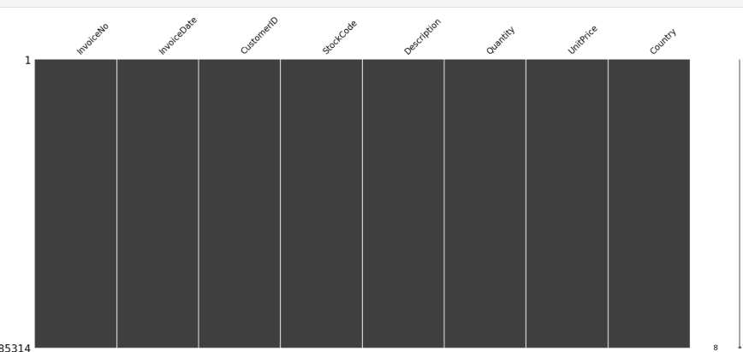
The chart to the right is a missingness
Matrix which simply allows us to visualize
Missing values and shows that in the
Entire dataset there are no missing values

Slide 6
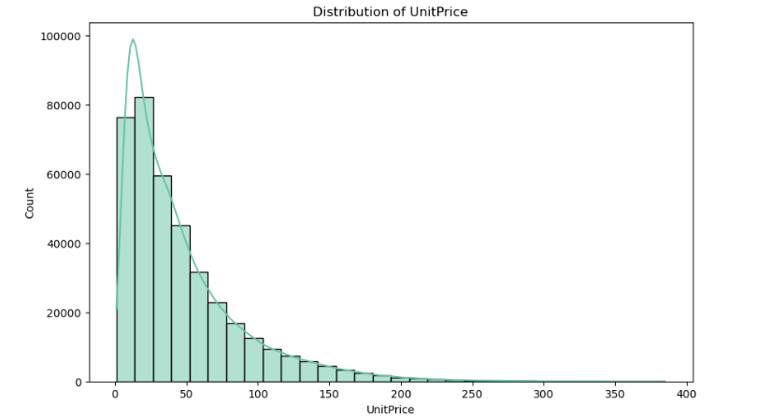
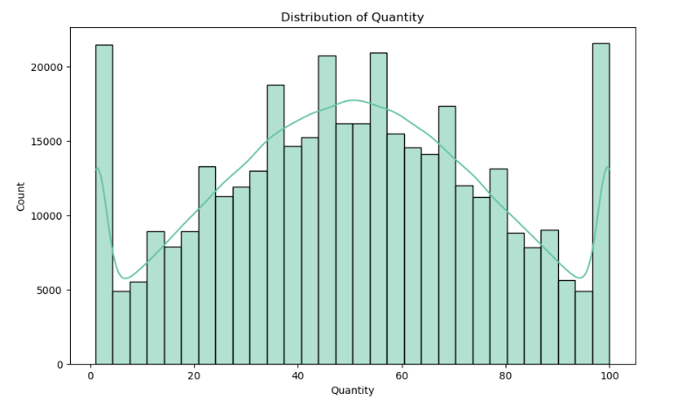
The charts to the right show the distribution of Unit Price
and Quantity in the dataset. The distribution of Quantity
seems to be normally distributed but there is a presence
of outliers on the far left and right. The distribution of
The UnitPrice distribution is skewed left confirming the
Presence if outliers to the right

Slide 7
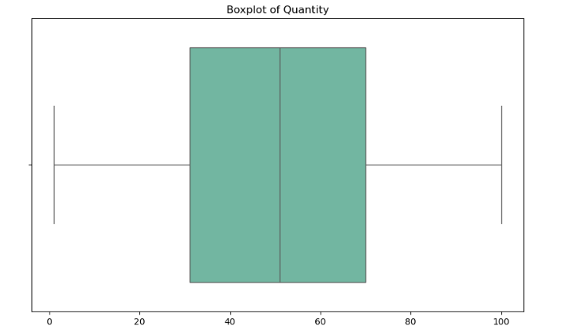
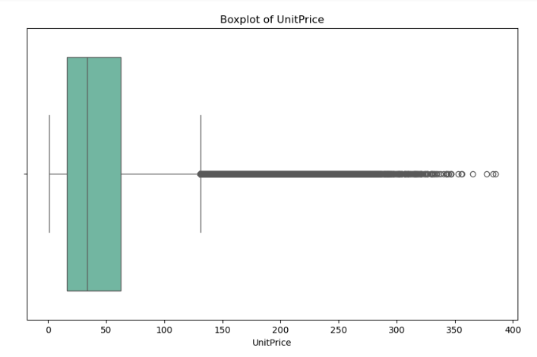
The Boxplots to the left confirm my suspicion of the
Presence of some outliers in the Quantity feature and
much more in the UnitPrice Feature

Slide 8
Customer Segmentation Analysis
In this section I will be identifying patterns for meaningful segmentation of the dataset, particularly customers from the United States, United Kingdom and different tiers of customers based on their purchase patterns

Slide 9
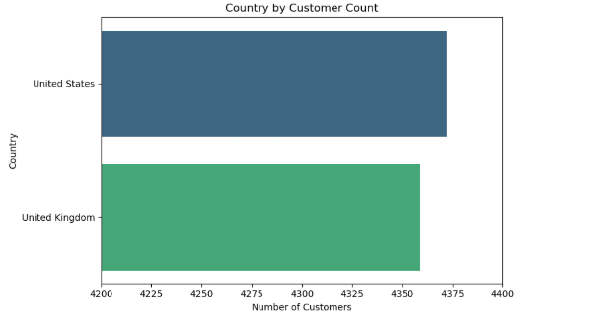

To the right we can see a graph showing the segmentation of customers of Shopsphere in the
United States (4372) in comparison to customers from the
United Kingdom (4359) with customers from the united states being more

Slide 10
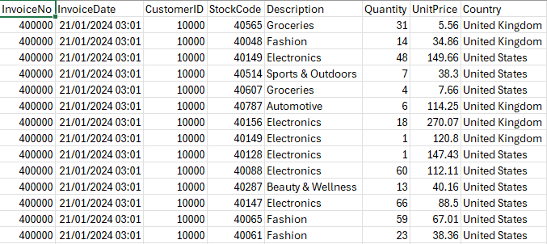
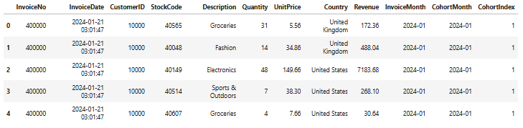
The tables to the right show the original table
and a few additions to the original table by splitting
InvoiceDate to InvoiceMonth, CohortMonth and
CohortIndex we are able to get a wider view of
customer patterns by grouping customers by their
first purchase (CohortMonth) and tracking how
many of them continue purchasing in the following
months (InvoiceMonth).

Slide 11
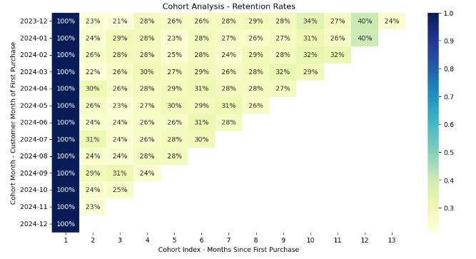
The heatmap to the right is a cohort analysis chart that
Tells us about customer loyalty over time. From the chart
We can see that:
Most cohorts drop from 100% → ~25–30% after 1–2 months — meaning about 1 in 4 customers keep buying after
their first month.
Some later cohorts (like 2024-03 or 2024-06) show slightly better retention (~30% after several months), suggesting
customer retention is improving.
The bottom rows are shorter because those customers haven’t been around long enough to measure long-term retention yet.

Slide 12
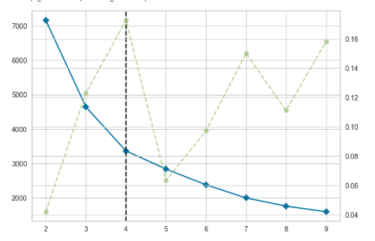
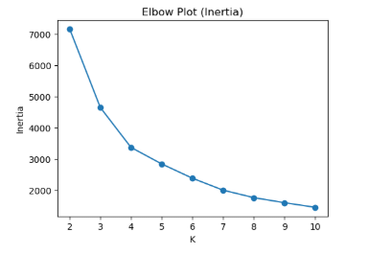
The plots to the right are elbow plots that shows the clusters
And helps us decide the optimal number of clusters with the ideal
Number found at the point where the curve visibly bends in our case
That point is point 4. This helps us to group our pre existing clusters into groups each representing a point (ie 0,1,2,3,4). The groups are shown below
0: 'VIPs', 1: 'Loyal Regulars', 2: 'At Risk / Lost’, 3: 'V-VIPs',

Slide 13
Actionable Insights
In this section I will be presenting actionable insights from the above Exploratory data analysis. This insight will influence customer retention positively, and
Identify some of the key factors influencing retention

Slide 14
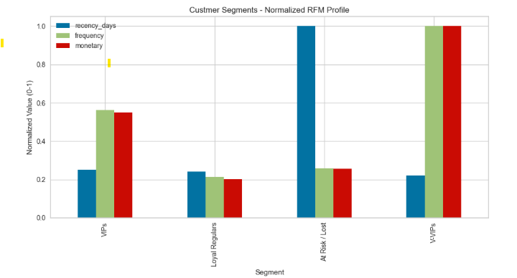
Factors influencing retention:
Customers who bought recently are more likely to stay active.
Customers who buy more often tend to keep returning.
Customers who spend more usually show stronger loyalty.
Retention can vary by country, depending on delivery and customer experience.
Some customers return more during sales seasons or holidays.
Retention also depends on what products people buy — for example, consumable items often lead to repeat purchases.
The chart to the right shows the recency days,
frequency and monetary values for each group

Slide 15
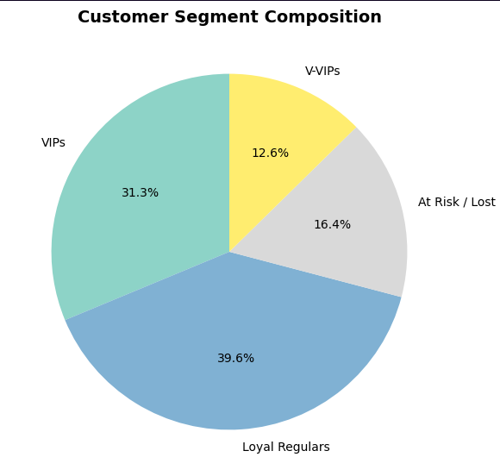
Pie chart showing the Distribution of retained vs churned customers.
Insight to Support customer growth:
After their first month, only about 25–30% of customers keep buying.
This means most customers buy once and then stop.
Focusing on the first 30 days after a purchase can help keep more customers active.
Recent customer groups (like those from March and June 2024) are showing slightly better retention.
This means new marketing or customer experience efforts are working.
High-value customers spend more and buy more often, but they are fewer in number.
Special treatment for these customers, like loyalty programs or early access deals, can help keep them longer.
One-time buyers are the biggest reason for churn.
Sending reminders, discounts, or personalized offers can bring them back.
Retention also differs by region or market.
Learning from high-performing areas can help improve other regions.

Slide 16
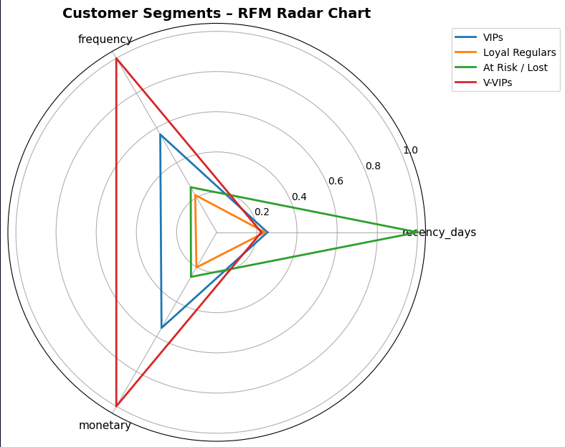
Insight to support customer lifetime growth:
The more often customers buy, the higher their lifetime value.
Loyal customers are both profitable and easier to retain.
Low-value customers often leave early but can be reactivated.
Grouping customers by RFM (Recency, Frequency, Monetary) helps send better offers.
Keeping customers active beyond their first month can double CLV.
The radar chart above highlights distinct customer behaviors based on RFM scores. V-VIPs are the most valuable group, with high spending, frequent, and recent purchases. VIPs remain active with solid engagement, while Loyal Regulars show moderate but steady activity. At Risk / Lost customers have not purchased recently and show low frequency and spending. This segmentation provides a clearer view of customer value and helps guide targeted retention and marketing strategies.

Slide 17
Actionable insights for each group
Customer Segment | Profile Summary | Goal | Recommended Retention & Marketing Strategies
🟥 V-VIPs (Very Valuable, Very Active) | Highest spenders, very frequent, and most recent purchasers. | Maintain loyalty and strengthen brand connection. | • Offer early access to new collections or exclusive sales.• Send personalized rewards and thank-you gifts.• Create premium membership tiers or VIP events.• Engage them in community or product beta programs.
🟦 VIPs (Active, Valuable Customers) | High engagement and spend, but slightly less frequent than V-VIPs. | Encourage higher purchase frequency and average order value. | • Provide bundle or upsell recommendations.• Use reminder emails for loyalty points or unused coupons.• Offer “Buy More, Save More” campaigns.• Request feedback to enhance brand attachment.
🟧 Loyal Regulars (Steady Shoppers) | Consistent buyers with moderate frequency and spend. | Increase basket size and strengthen loyalty. | • Use personalized product recommendations.• Introduce gamified loyalty or referral programs.• Offer milestone discounts after repeat purchases.• Promote subscription or auto-reorder options.
🟩 At Risk / Lost Customers | Low engagement and spending; long gap since last purchase. | Reactivate interest and recover churned customers. | • Send “We miss you” reactivation emails with limited-time offers.• Retarget with products previously viewed.• Offer incentives for survey completion to learn drop-off reasons.• Highlight new arrivals or trending products.

Slide 18
Thank you!

